Slide 1
LEARNING OUTCOMES
As a result of the lesson you will be able to:
describe the three hypotheses of DNA replication;
describe the Meselson-Stahl experiment and explain its significance;
explain the molecular mechanism of semiconservative DNA replication;
explain the role of main enzymes implicated in the replication process;
explain proofreading mechanisms and error correction during DNA replication.

Slide 2
Literature
Alberts et al., pp. 239-266.
Cooper GM. The Cell: A Molecular Approach. (https://www.ncbi.nlm.nih.gov/books/NBK9940/)

Slide 3
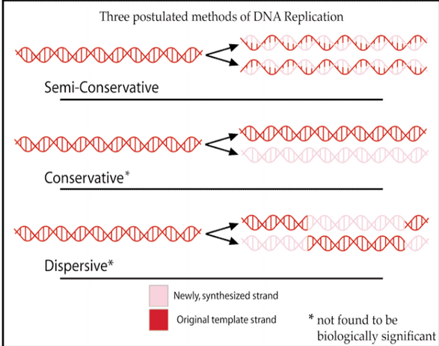
Case: “Most elegant experiment in molecular biology”
— in 1958 Meselson and Stahl conducted the experiment that first demonstrated how DNA replication occurs. Here are three different possibilities for DNA replication. Only one really happens, but until Meselson & Stahl conducted their experiment, each of these was plausible.

Slide 4
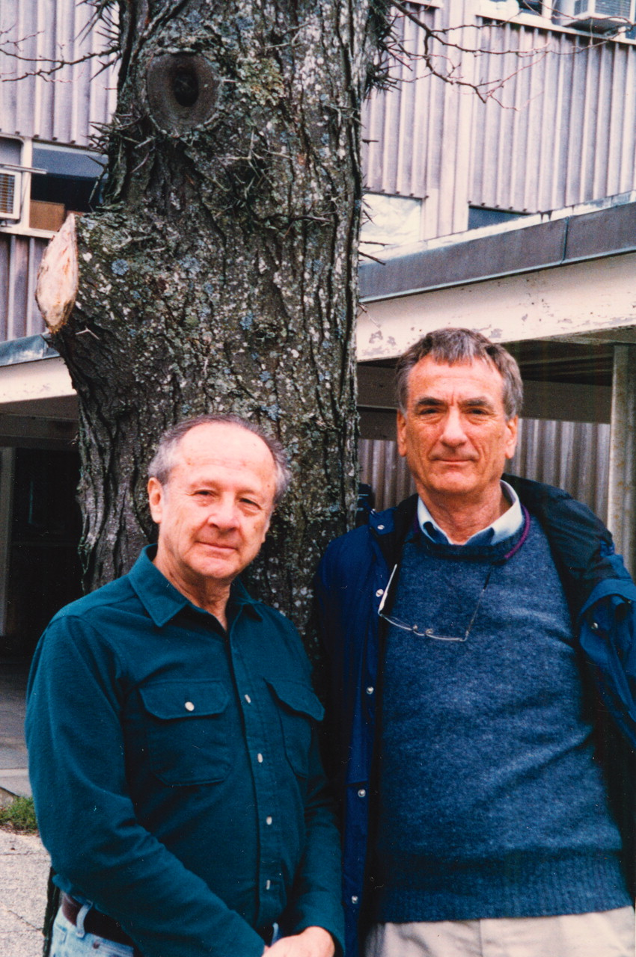
Meselson and Stahl used 14N and 15N.
1. Why is a nitrogen label a good tool for studying DNA?
2. What other molecules in a cell have nitrogen in them?
3. What’s the difference between 14N and 15N at the atomic level?
4. What’s the term for two atoms of the same element with different molecular masses?
5. Give an example of another element that has atoms of more than one molecular mass.
Meselson and Stahl

Slide 5
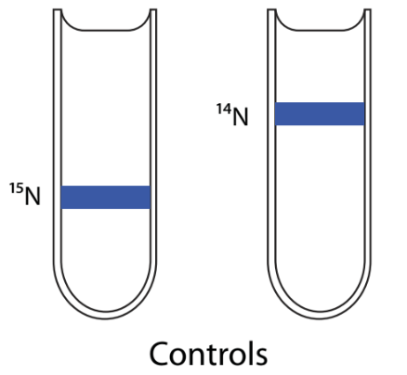
Meselson and Stahl grew bacteria in cultures containing only 15N nitrogen for many generations so that the DNA was almost entirely composed of 15N-containing nucleotides. These chromosomes are more dense than 14N chromosomes, and by spinning chromosomes at very high speeds in a density gradient tube, Meselson & Stahl could tell the difference between the two kinds of chromosomes. Heavy chromosomes sank farther to the bottom of the tube, where the liquid was more dense. Lighter chromosomes floated in the less dense liquid toward the top of the tube. This can be represented by the diagram. The blue lines represent the location of chromosomes in the tubes after centrifugation.

Slide 6
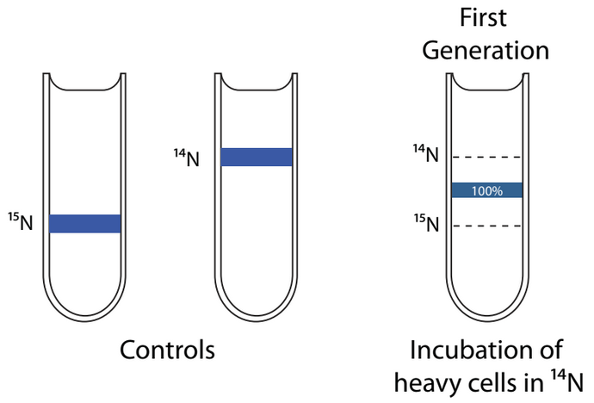
After growing the bacteria in 15N, producing bacteria with “heavy” chromosomes, they shifted the bacteria to growth conditions where only 14N was present—making all the newly synthesized DNA from this less dense form of nitrogen.
Here are the results of their density gradients after exactly one generation of bacterial growth:

Slide 7
Questions
1. Which of the three models for DNA replication are ruled out by this experiment?
2. What would the data look like if the model, you ruled out, was what really happening? Include a diagram of a tube as part of your answer.
3. What could they do to tell which of the two remaining models is actually happening, using the tools that have already been described?

Slide 8
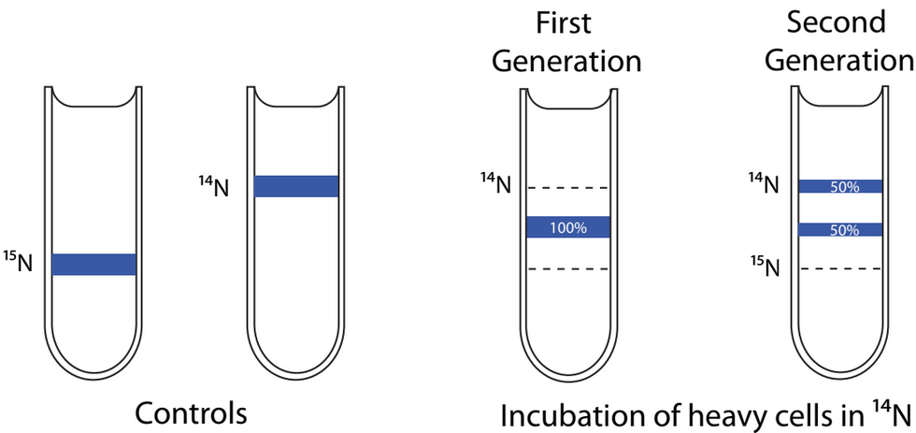
The diagram below shows the results from the experiment of the 2nd generation of cells grown in 14N.

Slide 9
Questions
1. Which model has now been ruled out by these results?
2. What would the data look like if this model was actually happening? Include a diagram of a test tube as part of your answer.

Slide 10
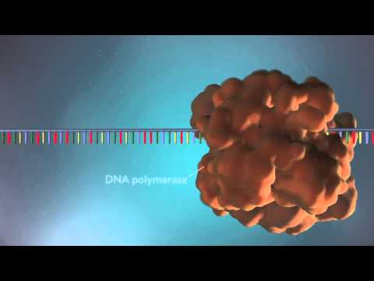
DNA replication video 1

Slide 11
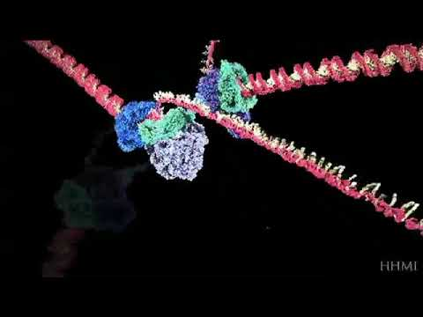
DNA replication video 2

Slide 12
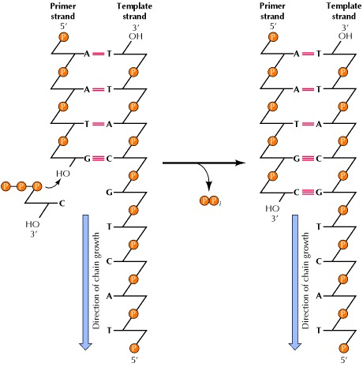
The reaction catalyzed by DNA polymerase. All known DNA polymerases add a deoxyribonucleoside 5′-triphosphate to the 3′ hydroxyl group of a growing DNA chain.

Slide 13
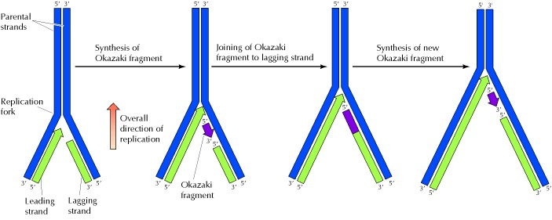
The leading strand is synthesized continuously in the direction of replication fork movement. The lagging strand is synthesized in small pieces (Okazaki fragments) backward from the overall direction of replication. The Okazaki fragments are then joined by the action of DNA ligase.

Slide 14
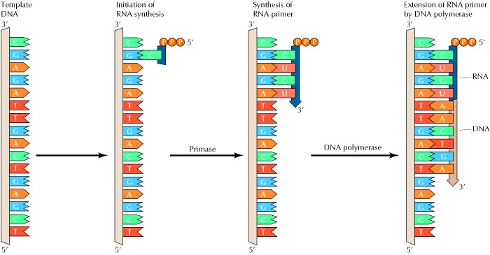
Initiation of Okazaki fragments with RNA primers
Short fragments of RNA serve as primers that can be extended by DNA polymerase.

Slide 15
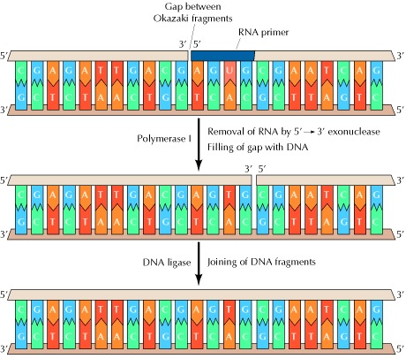
Removal of RNA primers and joining of Okazaki fragments
Because of its 5′ to 3′ exonuclease activity, DNA polymerase I removes RNA primers and fills the gaps between Okazaki fragments with DNA. The resultant DNA fragments can then be joined by DNA ligase.

Slide 16
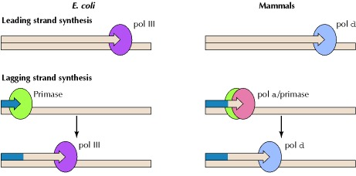
Roles of DNA polymerases in E. coli and mammalian cells
The leading strand is synthesized by polymerase III (pol III) in E. coli and by polymerase δ (pol δ) in mammalian cells. In E. coli, lagging strand synthesis is initiated by primase, and RNA primers are extended by polymerase III. In mammalian cells, lagging strand synthesis is initiated by a complex of primase with polymerase α (pol α). The short RNA-DNA fragments synthesized by this complex are then extended by polymerase δ.

Slide 17
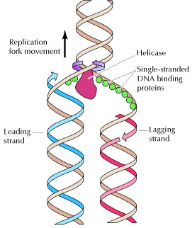
Action of helicases and single-stranded DNA-binding proteins
Helicases unwind the two strands of parental DNA ahead of the replication fork. The unwound DNA strands are then stabilized by single-stranded DNA-binding proteins so that they can serve as templates for new DNA synthesis.

Slide 18
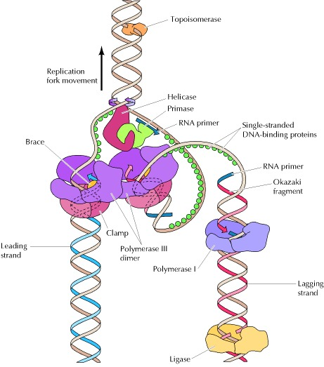
Helicase, primase, and two molecules of DNA polymerase III carry out coordinated synthesis of both the leading and lagging strands of DNA. The lagging strand template is folded so that the polymerase responsible for lagging strand synthesis moves in the same direction as overall movement of the fork. Topoisomerase acts as a swivel ahead of the fork, and DNA polymerase I and ligase remove RNA primers and join Okazaki fragments behind the fork.

